Slide 1
The Ribbon
The Ribbon

Slide 2
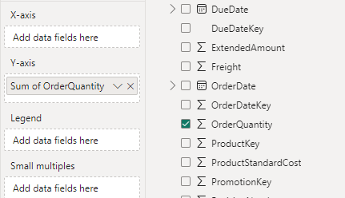
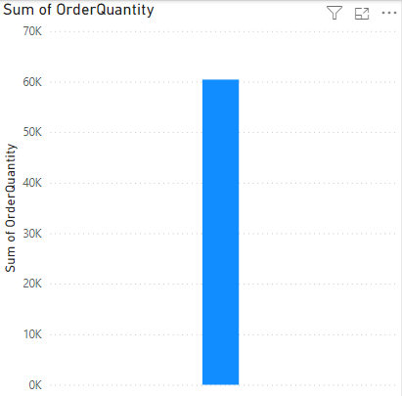
The Ribbon
Add a Ribbon to the scene and try to represent the OrderQuantity field By adding it to the Y-Axis
Note that it behaves exactly like a Stack Column

Slide 3
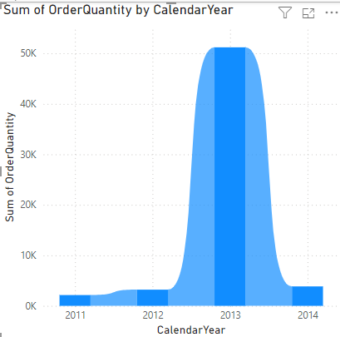
The Ribbon
Add Year field of the DimDate table to the X-Axis and notice the visual behavior

Slide 4
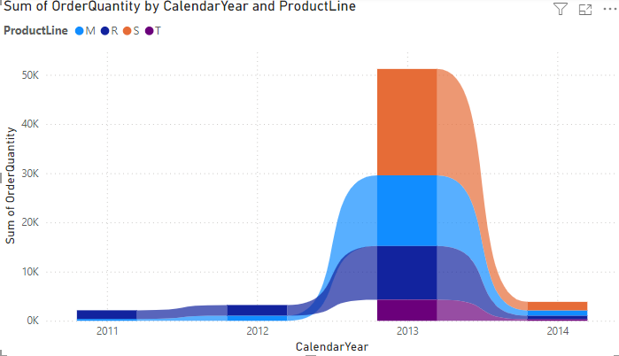
The Ribbon
Now let's try to analyze the data based on the ProductLine of DimProduct by adding it to the Legend parameter

Slide 5
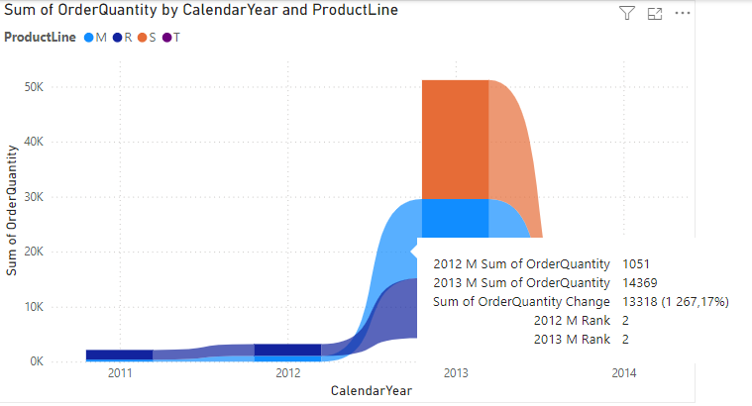
The Ribbon
Try positioning the cursor on the first column and then between the first and second columns
Note that at the tooltip level you find the rank, also note the differential value of the quantities in addition to the values of successive quantities

Slide 6
Thank you
Thank you

